Slide 1


Akeeal Mohammed
14/10/2024

Slide 2

Outline
Executive Summary - 3
Introduction
Methodology
Results
Conclusion
Appendix

Slide 3
Executive Summary
I sourced data from publicly available SpaceX API and Wikipedia resources. To prepare the data for analysis, I created a 'class' column to categorize successful landings. I then utilized SQL queries, data visualization techniques, and interactive maps to explore the dataset. This allowed me to identify relevant features and transform categorical variables into binary formats using one-hot encoding. After standardizing the data, I employed GridSearchCV to optimize hyperparameters for various machine learning models. The accuracy scores of each model were visualized to facilitate comparison.
My analysis yielded four distinct machine learning models: Logistic Regression, Support Vector Machine, Decision Tree Classifier, and K-Nearest Neighbors. Notably, all models achieved similar performance, with an accuracy rate of approximately 83.33%. However, it is evident that additional data is necessary to refine model selection and enhance accuracy."

Slide 4
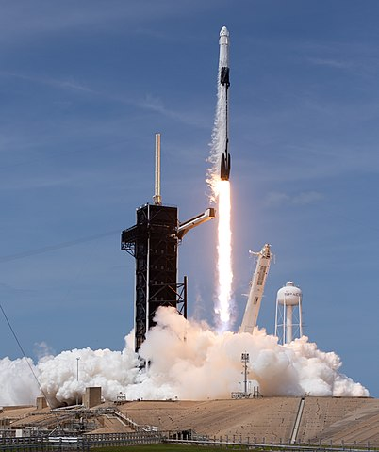
Introduction
Background:
The Commercial Space Age is Revolutionizing the Industry
Astra Aerospace is leading the charge with unprecedented pricing ($62 million vs. $165 million USD)
Their secret to success lies in their innovative approach to rocket reusability, specifically the recovery of Stage 1 Nova Launch Systems is determined to challenge Astra's dominance
Problem: Nova Launch Systems has tasked us with developing a machine learning model to predict successful Stage 1 recovery, enabling them to optimize their launch operations and gain a competitive edge in the market.
Falcon 9 - By Joel Kowsky

Slide 5

Section 1

Slide 6
Methodology
Executive Summary
Data collection methodology:
Aggregated data from two publicly available sources: the SpaceX API and Wikipedia page
Perform data wrangling
Cleaned and preprocessed the data to ensure accuracy and consistency
Labeled the data by categorizing landings as successful or unsuccessful
Conducted exploratory data analysis using a combination of data visualization techniques and SQL queries to gain insights into the data
Perform exploratory data analysis (EDA) using visualization and SQL
Perform interactive visual analytics using Folium and Plotly Dash
Perform predictive analysis using classification models
Created interactive visualizations using Folium and Plotly Dash to further examine the data and identify patterns
Employed classification models to predict successful landings and optimized the models using GridSearchCV to achieve the best possible performance

Slide 7
Data Collection
Our data collection process involved a hybrid approach, combining API requests from Astra Aerospace's public API and targeted web scraping from a relevant table on their Wikipedia page.
Please refer to the subsequent slides for detailed flowcharts illustrating the API-based data collection process and the web scraping methodology.
The Astra Aerospace API provided the following data points:
Flight identification information (Flight Number, Serial)
Mission details (Date, Payload Mass, Orbit, Launch Site)
Booster specifications (Booster Version, Block, Reused Count)
Landing and recovery data (Landing Pad, Grid Fins, Legs, Reused)
Geographic coordinates (Longitude, Latitude)
Additional information (Outcome, Flights)
The Wikipedia web scraping effort yielded the following data points:
Launch details (Flight No., Launch site, Date, Time)
Payload information (Payload, Payload Mass, Customer)
Launch outcome (Launch outcome)
Booster details (Version Booster, Booster landing)

Slide 8
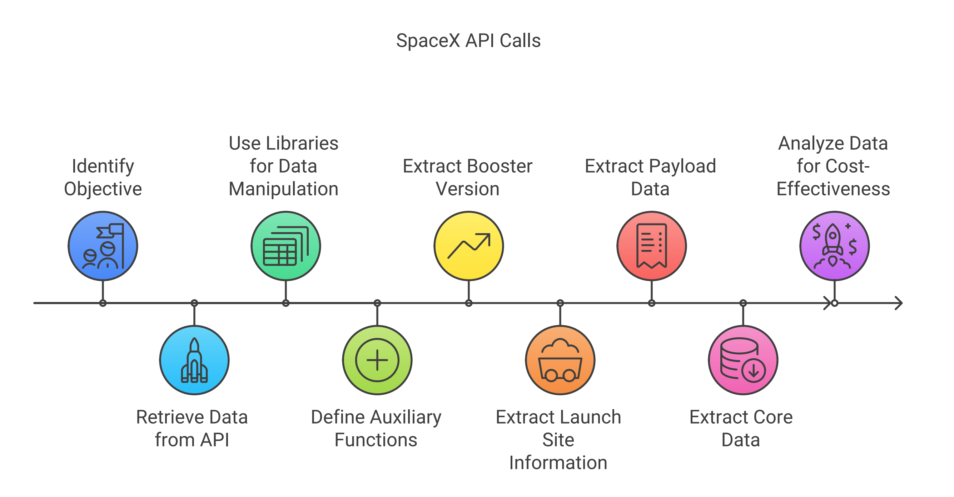
Data Collection – SpaceX API
Github URL:
https://github.com/Akeeal/Applied-Data-Science-Capstone/blob/main/jupyter-labs-spacex-data-collection-api-v2.ipynb

Slide 9
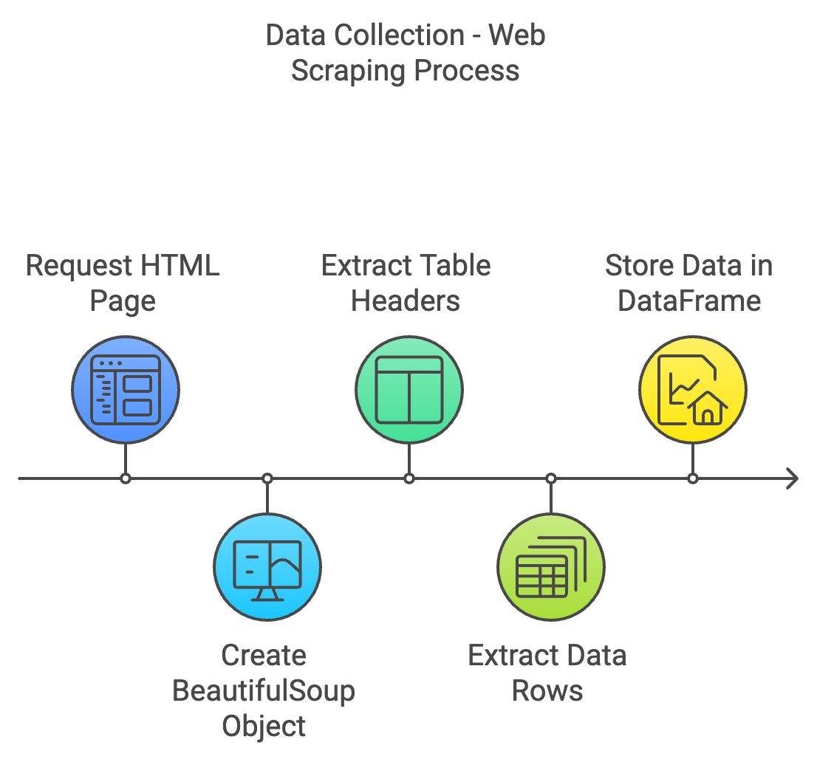
Data Collection - Scraping
Github URL:
https://github.com/Akeeal/Applied-Data-Science-Capstone/blob/main/jupyter-labs-webscraping.ipynb

Slide 10
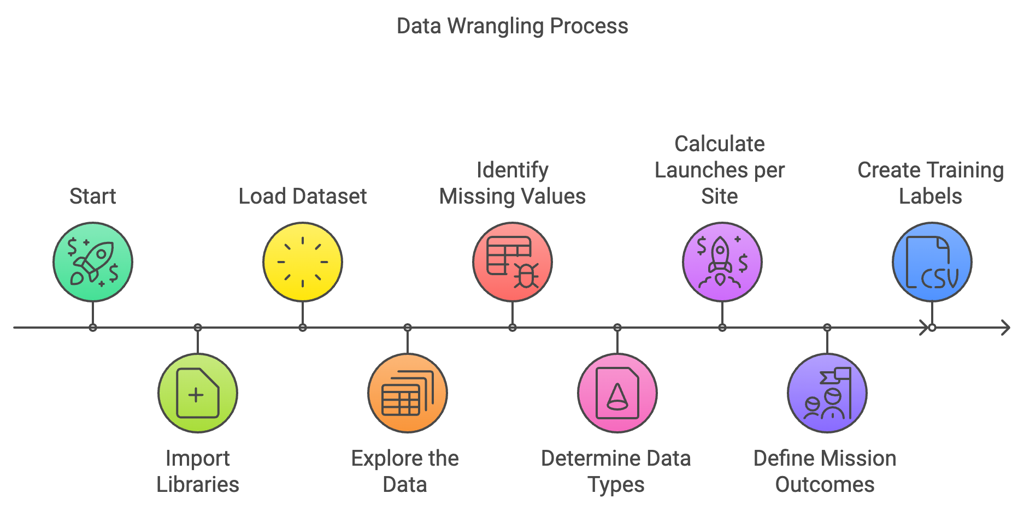
Data Wrangling
To prepare the data for modeling, we created a new target variable, 'class', to capture the success or failure of landing outcomes. This binary label was derived from the existing 'Outcome' column, which comprises two sub-components: 'Mission Outcome' and 'Landing Location'.
We assigned a value of 1 to the 'class' column when the 'Mission Outcome' was successful, and 0 otherwise. This mapping was based on the following rules:
Successful landings (ASDS, RTLS, and Ocean) were assigned a value of 1
Unsuccessful landings (None, False ASDS, None ASDS, False Ocean, and False RTLS) were assigned a value of 0
This transformation enabled us to create a clear and concise target variable for our machine learning models to predict.
Github URL:
https://github.com/Akeeal/Applied-Data-Science-Capstone/blob/main/labs-jupyter-spacex-Data%20wrangling-v2.ipynb

Slide 11
EDA with Data Visualization
To gain a deeper understanding of the data, we conducted an exploratory data analysis (EDA) on a subset of key variables, including Flight Number, Payload Mass, Launch Site, Orbit, Class, and Year.
Our EDA involved creating a range of visualizations to examine the relationships between these variables, including:
Correlation plots to investigate the relationship between Flight Number and Payload Mass, as well as Launch Site and Orbit
Success rate analysis to determine how Orbit impacts the likelihood of a successful landing
Temporal analysis to identify any trends in success rates over time
Comparative plots to examine the relationship between Payload Mass and Orbit, as well as Flight Number and Orbit
By using a combination of scatter plots, line charts, and bar plots, we aimed to identify potential correlations and patterns in the data that could inform the development of a machine learning model.
Github URL:
https://github.com/Akeeal/Applied-Data-Science-Capstone/blob/main/jupyter-labs-eda-dataviz-v2.ipynb

Slide 12
EDA with SQL
The dataset was successfully imported into an IBM DB2 Database. Utilizing the SQL Python integration, a series of queries were executed to gain a deeper understanding of the dataset's structure and content.
These queries focused on extracting insights into key aspects of the data, including:
Launch site names and their corresponding characteristics
Mission outcomes, including successes and failures
Payload sizes and types of customers
Booster versions and their associated characteristics
Landing outcomes, including successful and unsuccessful landings
Github URL:
https://github.com/Akeeal/Applied-Data-Science-Capstone/blob/main/jupyter-labs-eda-sql-coursera_sqllite.ipynb

Slide 13
Build an Interactive Map with Folium
Utilizing Folium maps, we visualized the geographical distribution of launch sites, highlighting both successful and unsuccessful landings. This approach enabled us to gain insights into the spatial relationships between launch sites and their proximity to key locations such as railways, highways, and cities.
By examining the geographical distribution of launch sites, we can better understand why certain locations are more or less conducive to successful landings. This allows us to identify potential factors influencing launch site selection, such as proximity to railways, highways, and cities.
Github URL:
https://github.com/Akeeal/Applied-Data-Science-Capstone/blob/main/Interactive%20Visual%20Analytics%20with%20Folium.ipynb

Slide 14
Build a Dashboard with Plotly Dash
Our data visualization dashboard features a combination of interactive charts, including a pie chart and a scatter plot.
The pie chart allows users to select specific launch sites and view their corresponding success rates, providing insights into the distribution of successful landings across all launch sites.
The scatter plot offers an interactive visualization, enabling users to explore the relationship between launch site success rates, payload mass, and booster version. The plot can be filtered by launch site or individual site, with a slider allowing users to adjust the payload mass range from 0 to 10,000 kg.
Github URL:
https://github.com/Akeeal/Applied-Data-Science-Capstone/blob/main/Interactive%20Visual%20Analytics%20and%20Dashboard.ipynb

Slide 15
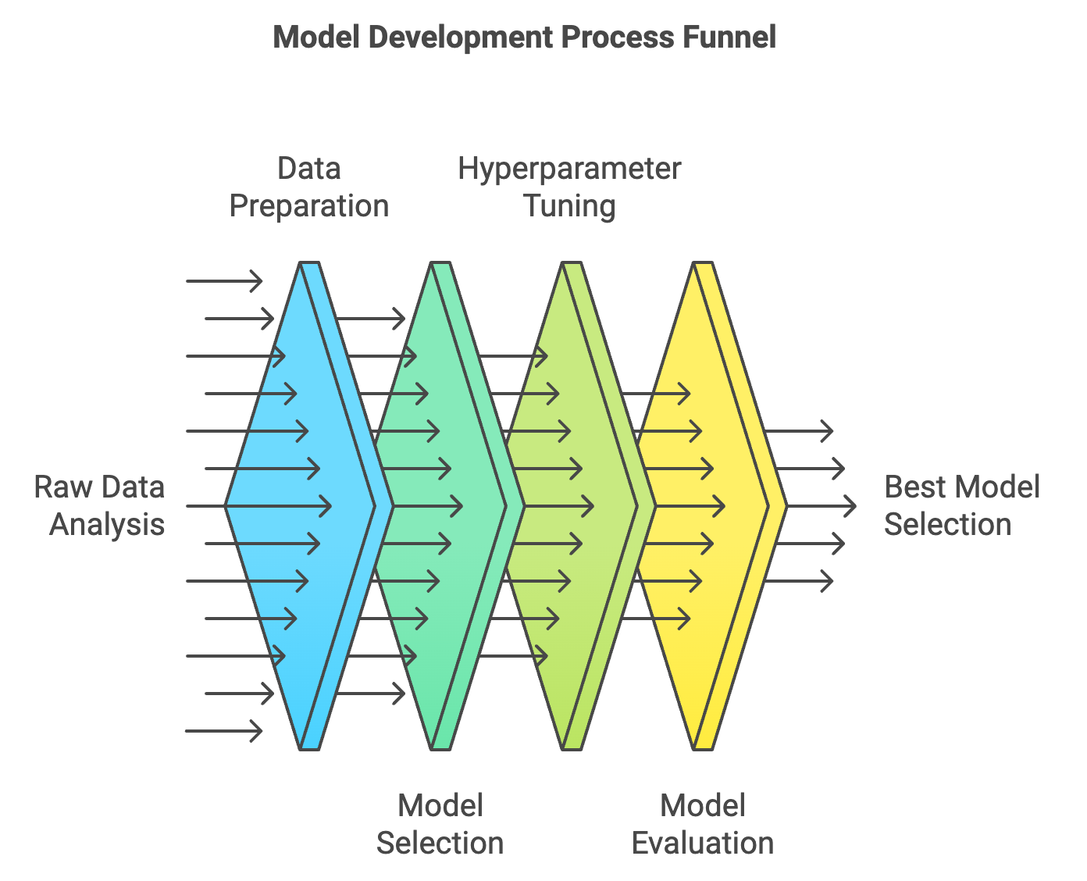
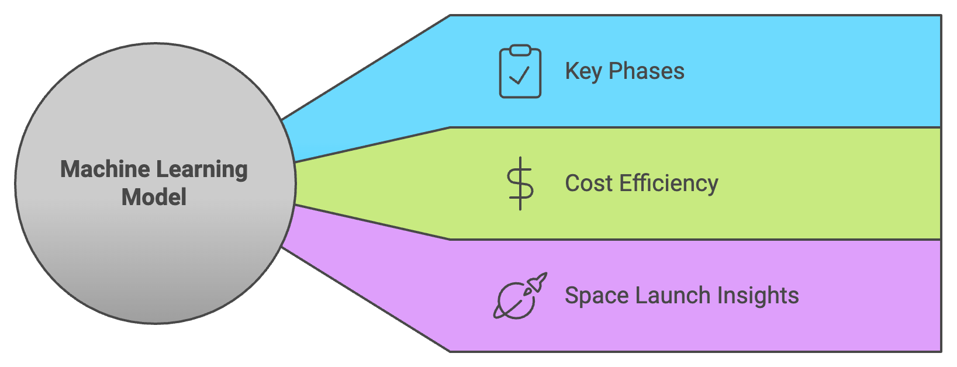
Predictive Analysis (Classification)
Github URL:
https://github.com/Akeeal/Applied-Data-Science-Capstone/blob/main/SpaceX-Machine-Learning-Prediction-Part-5-v1.ipynb

Slide 16
Results
Exploratory data analysis results
Interactive analytics demo in screenshots
Predictive analysis results

Slide 17

Section 2

Slide 18
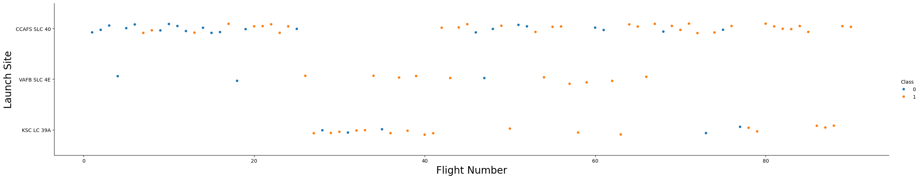
Flight Number vs. Launch Site
Scatter plot of Flight Number vs. Launch Site
On examining the scatter plot of Flight Number vs. Launch Site, we observe that the launch sites are not evenly distributed across the range of flight numbers. Some launch sites, such as KSC LC-39A, have a higher frequency of launches across a wider range of flight numbers, while others, such as VAFB SLC-4E, have fewer launches and are concentrated within a narrower range of flight numbers.

Slide 19
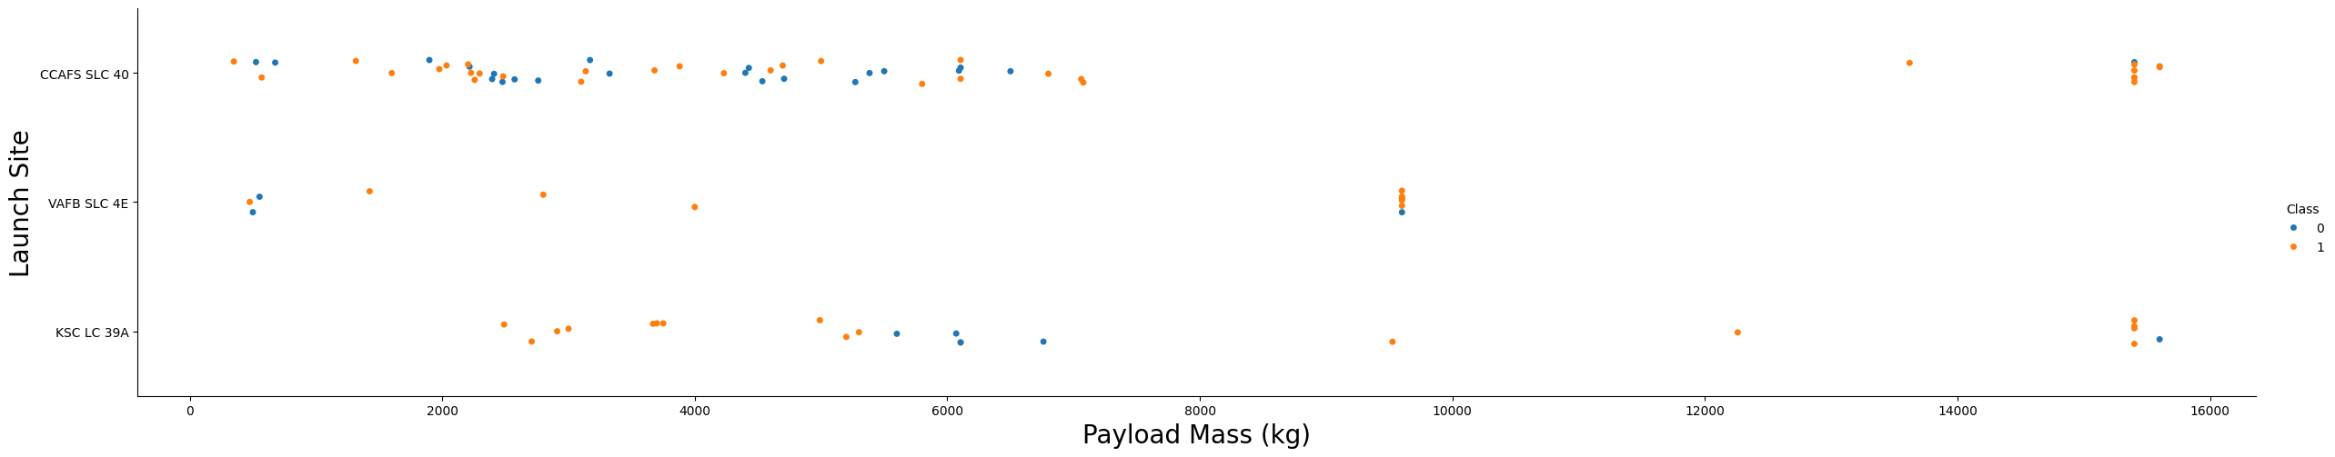
Payload vs. Launch Site
Examining the scatter plot of Payload vs. Launch Site, we observe several patterns. Firstly, we notice that the launch sites have varying payload capacities, with some sites like KSC LC-39A and CCAFS SLC-40 handling relatively heavier payloads compared to others like VAFB SLC-4E.
We also observe that the successful landings are more densely clustered within a certain range of payload masses for each launch site. For instance, KSC LC-39A has a higher success rate for payloads within the range of 4000-6000 kg, while CCAFS SLC-40 has a higher success rate for payloads within the range of 2000-4000 kg.
Furthermore, we notice that some launch sites, such as VAFB SLC-4E, have a lower success rate for heavier payloads (above 10000 kg), indicating that these sites may have limitations in handling larger payloads.
Additionally, we observe that the unsuccessful landings are more scattered across the payload range for each launch site, indicating that the factors contributing to unsuccessful landings may be more complex and influenced by multiple factors.
Overall, the scatter plot of Payload vs. Launch Site provides valuable insights into the relationship between payload capacity and launch site success rates, which can inform future launch planning and optimization efforts.

Slide 20
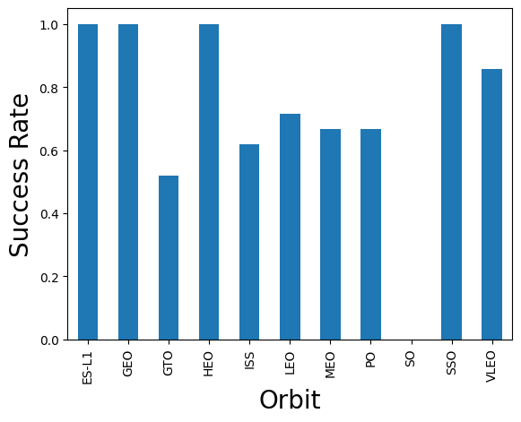
Success Rate vs. Orbit Type
Bar chart for the success rate of each orbit type
An examination of the success rates for different orbit types reveals some notable trends. Specifically, the ES-L1, GEO, and HEO orbits have achieved perfect success rates, albeit with limited sample sizes. In contrast, the SSO orbit has demonstrated a 100% success rate across a slightly larger number of attempts.
The VLEO orbit has shown a respectable success rate, with a relatively high number of attempts. On the other hand, the SO orbit has struggled, with a 0% success rate.
Notably, the GTO orbit has yielded a success rate of approximately 50%, which is a more moderate outcome. This orbit type has also had the largest sample size, suggesting that it may be a more frequently used orbit.

Slide 21
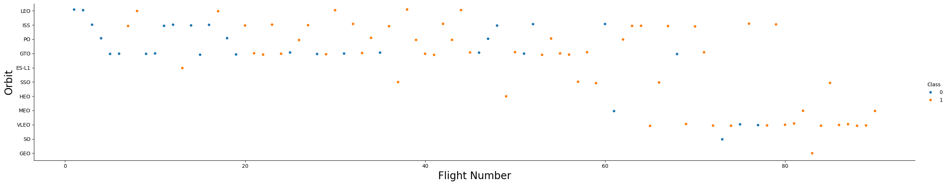
Flight Number vs. Orbit Type
Scatter point of Flight number vs. Orbit type
The color-coded plot reveals a shift in SpaceX's launch orbit preferences over time, with successful launches (orange) and unsuccessful launches (blue) displaying distinct patterns. Notably, the company's performance appears to be correlated with its orbit selection.
Initially, SpaceX focused on LEO orbits, achieving moderate success. However, more recent launches have seen a return to VLEO orbits, where the company has demonstrated improved performance. This suggests that SpaceX may be more effective in lower orbits or Sun-synchronous orbits.

Slide 22
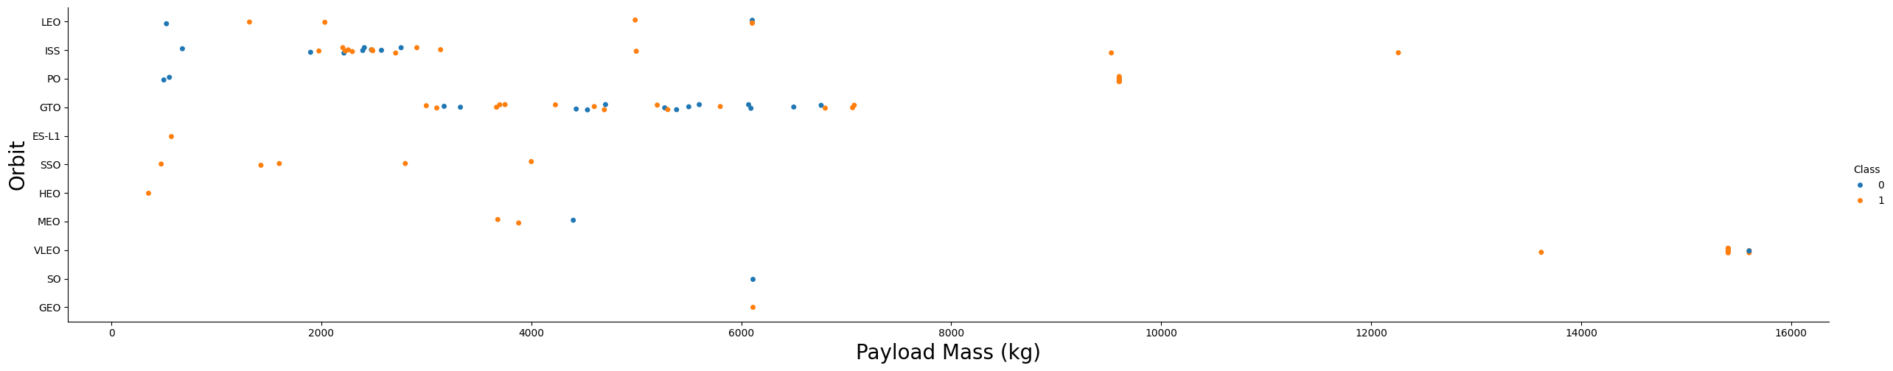
Payload vs. Orbit Type
Scatter point of payload vs. orbit type
The plot suggests a relationship between payload mass and orbit type. Specifically, LEO and SSO orbits tend to have lower payload masses, while VLEO orbits, which have a high success rate, are associated with higher payload masses.

Slide 23
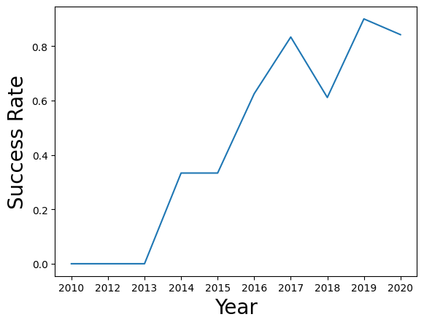
Launch Success Yearly Trend
Line chart of yearly average success rate
The success rate since 2013 kept increasing till 2017 (stable in 2014) and after 2015 it started increasing, In recent years the success been around 80%

Slide 24
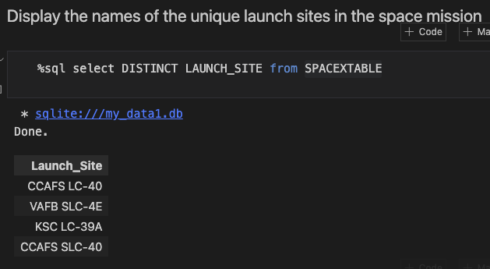
All Launch Site Names
Find the names of the unique launch sites
These are the names of the unique launch sites in the dataset.

Slide 25
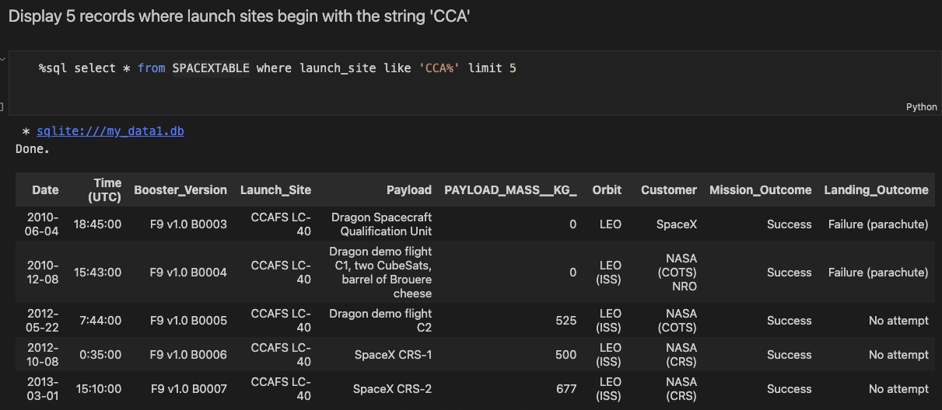
Launch Site Names Begin with 'CCA'
These are the first 5 records where the launch site starts with CCA.

Slide 26
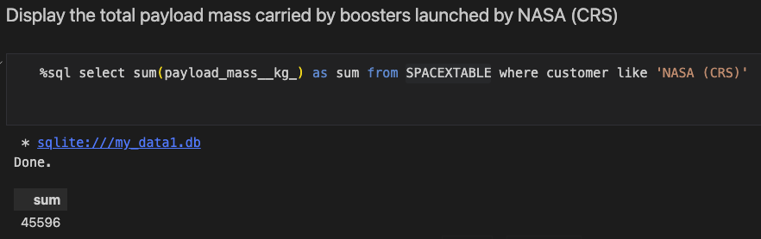
Total Payload Mass

Slide 27
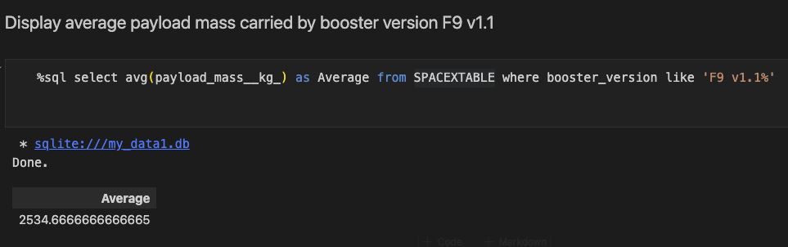
Average Payload Mass by F9 v1.1
Calculate the average payload mass carried by booster version F9 v1.1

Slide 28
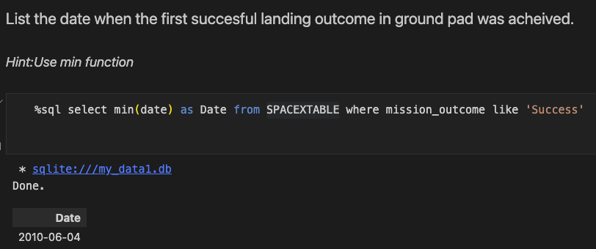
First Successful Ground Landing Date
The dates of the first successful landing outcome on ground pad

Slide 29
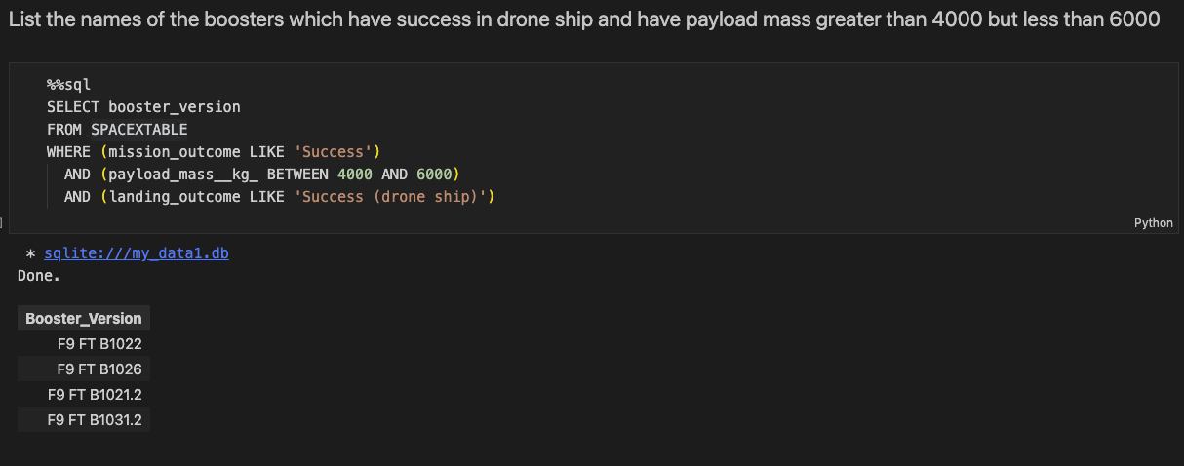
Successful Drone Ship Landing with Payload between 4000 and 6000
List the names of boosters which have successfully landed on drone ship and had payload mass greater than 4000 but less than 6000

Slide 30
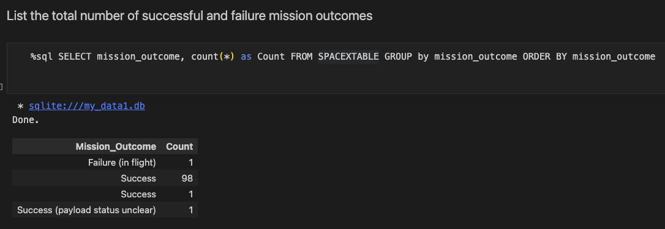
Total Number of Successful and Failure Mission Outcomes
Calculate the total number of successful and failure mission outcomes

Slide 31
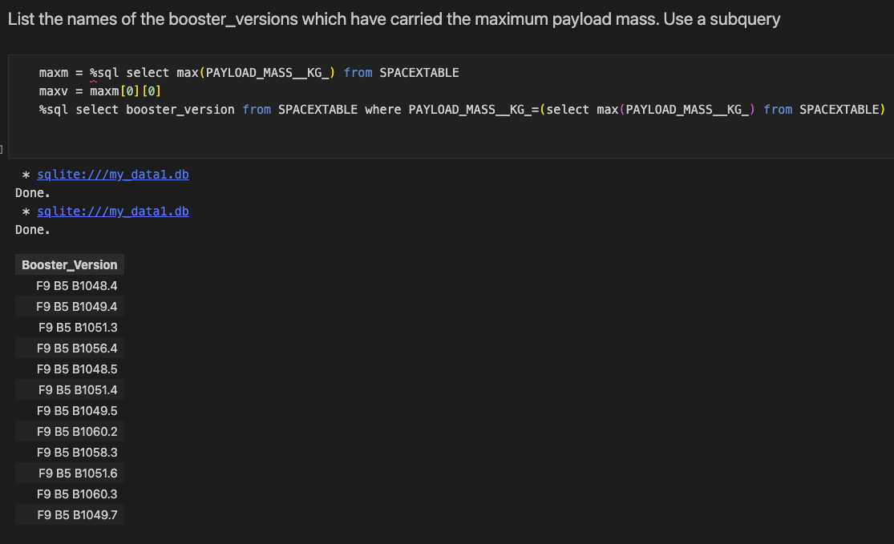
Boosters Carried Maximum Payload
List the names of the booster which have carried the maximum payload mass

Slide 32
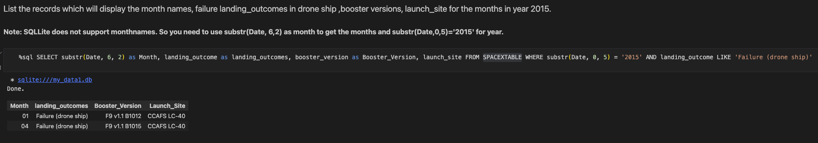
2015 Launch Records
List the failed landing_outcomes in drone ship, their booster versions, and launch site names for in year 2015

Slide 33
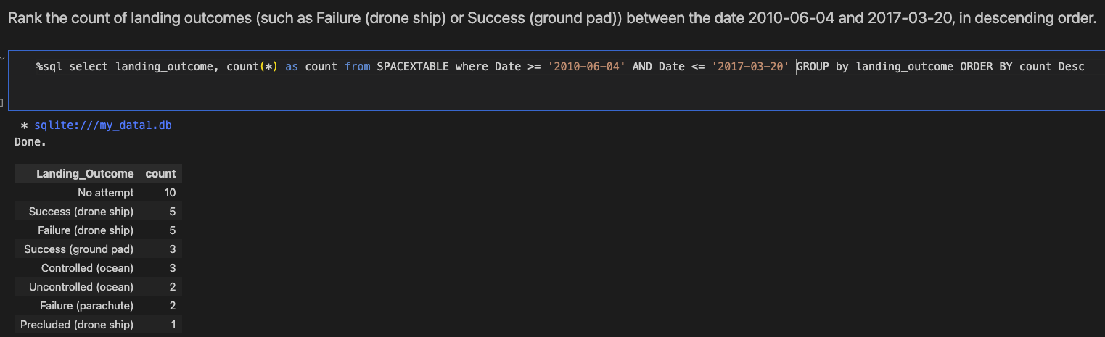
Rank Landing Outcomes Between 2010-06-04 and 2017-03-20
Rank the count of landing outcomes (such as Failure (drone ship) or Success (ground pad)) between the date 2010-06-04 and 2017-03-20, in descending order

Slide 34

Section 3

Slide 35
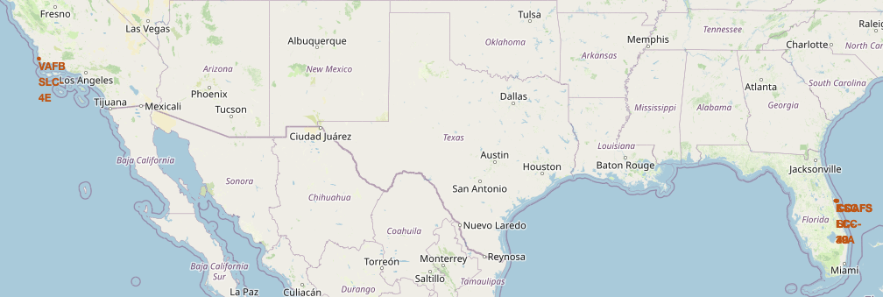
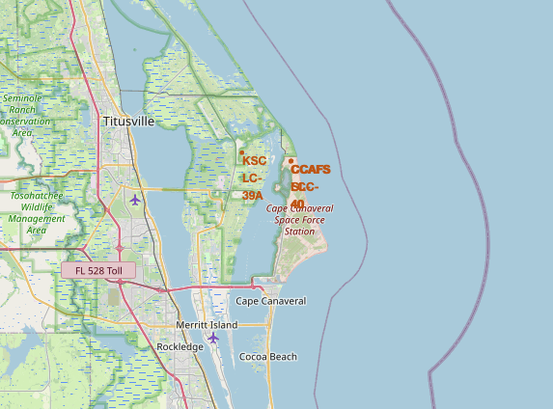
Launch Sites - Locations
Explore the generated folium map and make a proper screenshot to include all launch sites’ location markers on a global map
The left map shows the launch sites. The two Florida launch sites since they are very close to each other on the right map shows.

Slide 36
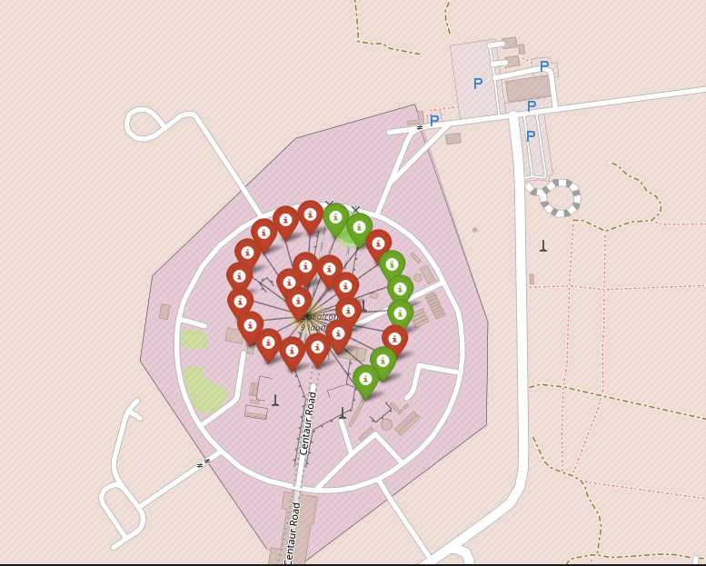
Colour-Labeled Markers - Launches
Explore the folium map and make a proper screenshot to show the color-labeled launch outcomes on the map
The markers are colour-coded, with green indicating successful launches and red indicating failed launches. The map also features a cluster of markers at each launch site, allowing users to visualize the density of launches at each location. Some important elements and findings on the map include:
Launch site distribution: The map shows that launch sites are concentrated in certain regions, with a higher density of sites near the equator.
Success rates: The color-coding of markers allows users to quickly identify launch sites with high success rates (green) and those with lower success rates (red).
Launch site clusters: The clustering of markers at each launch site provides a visual representation of the number of launches that have taken place at each location.
Geographical patterns: The map may reveal geographical patterns or correlations between launch site locations and success rates, such as a higher success rate for sites located near the coast or at lower latitudes.
By analyzing the map, users can gain insights into the relationships between launch site locations, success rates, and other geographical factors, which can inform decisions about future launch site selection and optimization.

Slide 37
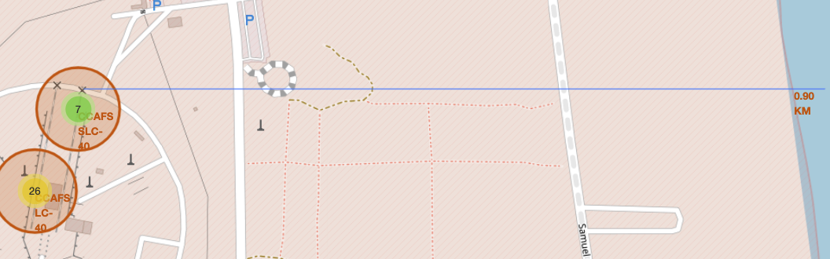
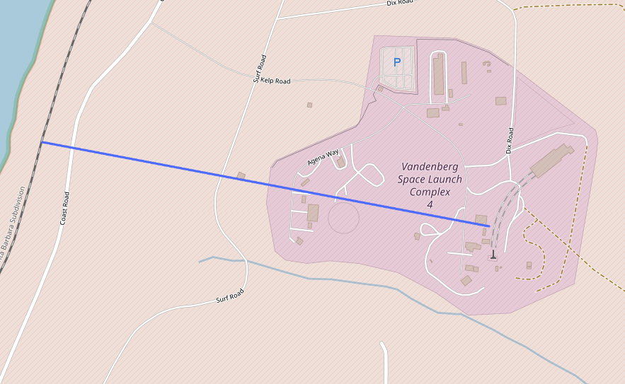
Key Locations
The important elements and findings on the map include:
Launch site location: The map shows a launch site marked with a specific coordinate (34.632834, -120.610746).
Railway point: A nearby railway point is marked with a specific coordinate (34.63494, -120.62429), which is approximately 0.27 km away from the launch site.
Distance line: A line is drawn between the launch site and the railway point, indicating the distance between the two locations.
Distance measurement: The distance between the launch site and the railway point is measured to be approximately 0.27 km, which is displayed on the map.
The findings on the map suggest that:
Proximity to railways: The launch site is in close proximity to a railway line, which could be an important factor in logistics and transportation of launch-related materials.
Geographical relationship: The map shows a clear geographical relationship between the launch site and the nearby railway point, which could be useful in planning and optimization of launch operations.
Distance to infrastructure: The measured distance between the launch site and the railway point provides insight into the accessibility of the launch site and the potential for transportation and logistics challenges.
By analyzing the map, users can gain insights into the relationships between launch site locations, nearby infrastructure, and geographical features, which can inform decisions about launch site selection, logistics, and operations.

Slide 38

Section 4

Slide 39
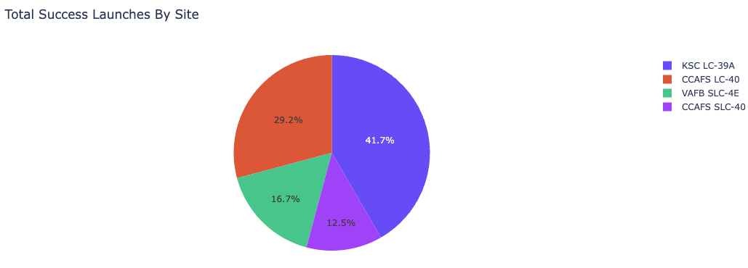
Successful Launches
The dropdown menu allows selection between different launch sites (CCAFS LC-40, VAFB SLC-4E, KSC LC-39A, CCAFS SLC-40) or view all sites at once, enabling analysis of success rates per site.
The pie chart visualizes launch success rates - either showing distribution across all sites or success/failure ratio for a specific site, helping identify which sites have the highest success rates.
The payload range slider (0-10,000 kg) lets users filter launches by payload mass, while the scatter plot shows the correlation between payload mass and launch success, coloured by booster version.
Key findings: Shows which site has the most successful launches, reveals optimal payload ranges for success, and indicates which booster versions perform best - allowing analysis of success factors across different variables.

Slide 40
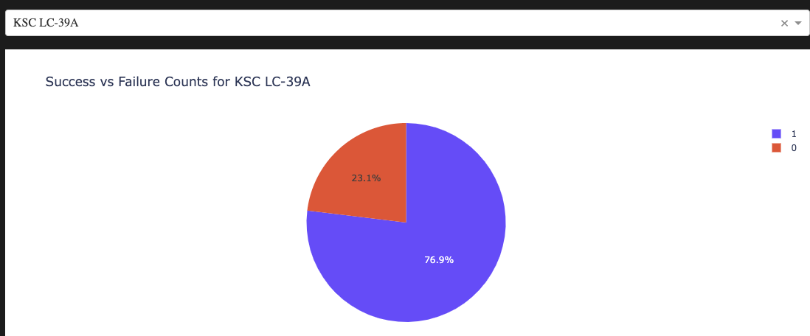
Highest Launch Success Ratio
Highest success rate with 10 successful landings and 3 failed landings is KSC LC-39A

Slide 41
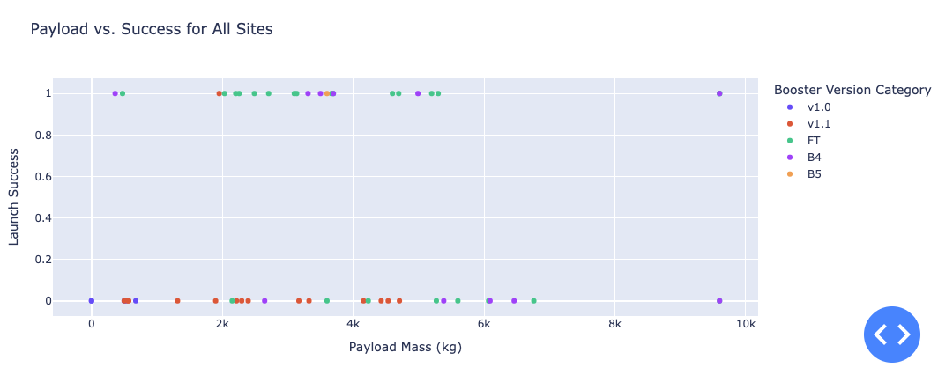
Payload VS Success for All Sites
The SpaceX launch data dashboard shows a 0-10000kg payload selector instead of the full 15600kg range. The scatter plot uses colours for booster versions and point sizes for launch frequency. Notably, in the 0-6000kg range, there are two failed landings (class=0) with zero payload. Success/failure is indicated by 1/0 in the class variable.

Slide 42

Section 5

Slide 43
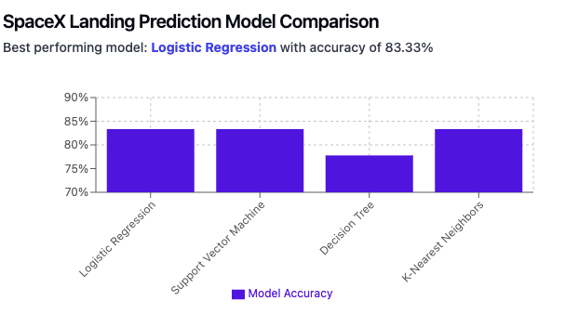
Classification Accuracy
Key findings from the corrected comparison:
Logistic Regression achieves 83.33% accuracy, tied with SVM and KNN
Three models (Logistic Regression, SVM, and KNN) show identical performance at 83.33%
Decision Tree performs slightly lower at 77.78%
While multiple models achieve the same accuracy, Logistic Regression might be preferred for its simplicity and interpretability
This visualization shows that while several models perform equally well, Logistic Regression could be considered the best choice due to its combination of high accuracy and model simplicity.

Slide 44
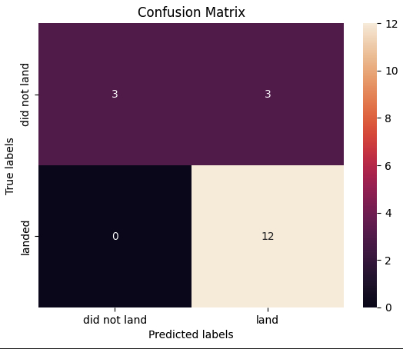
Confusion Matrix
The confusion matrix reveals identical performance across models with 83.33% accuracy. The models correctly identified 12 successful landings and had 3 correct unsuccessful landing predictions. The main limitation was 3 false positives, where failed landings were incorrectly predicted as successful. This suggests a model bias toward optimistic landing predictions, potentially due to the dataset's characteristics.

Slide 45
Conclusions
Purpose: Built a machine learning model to help Space Y compete in the launch market
Business Impact: Potential cost savings of ~$100M by predicting first-stage landing success
Data Sources: Combined SpaceX API data and Wikipedia page information
Tech Stack:
DB2 SQL database for data storage
Interactive dashboard for visualizations
ML model achieving 83% accuracy
Key Value: Enables Space Y to assess landing probability pre-launch, informing go/no-go decisions
Recommendation: Gather additional data to improve model accuracy and validate selection
Application: Provides Space Y with data-driven decision support for launch operations

Slide 46
Appendix
GitHub repository:
https://github.com/Akeeal/Applied-Data-Science-Capstone

Slide 47


